Slide 1

Intern Project Presentation
Intern: Andrej Lavrinovic

Slide 2
What has been done during three months of internship
Establishing of development environment for FKP Vodafone project
  IntelliJ IDE
  Db connection
  Maven
  Weblogic server
PeepingTom course
Jira bug testing
  Pen testing (GIS)
  QA testing (FKP)
Detection of misconfigured HTTP services project
  Script developed and established on Kali machine
  Execution scheduled
  Documentation appended
  Confluence page created
  Tickets have been raised

Slide 3
What I have learn
Objective
  Processes such as testing, developing, publishing
  Organisation of work such as meetings, walkthroughs
  Workflow it self
  Teamwork
  Little bit more about network
  Security
Particular thing:
  Using of intelliJ and PyCharm Interface development environments
  Weblogic and Tomcat servers specifications
  Svn version control
  Using of Workbench and SQLDeveloper (sql script building, exporting and importing)
  Jira, Confluence issue-tracking and project management platforms
  X OS (never used before), Kali (never heard before), redhat operating systems
  Amazone AWS platform with EC2 instance as a part of Detection of misconfigured HTTP services project
  Number of tools such as: wget, nano, nmap, hydra, EyeWitness, rawr, cron…may be more…
  Python programming language

Slide 4
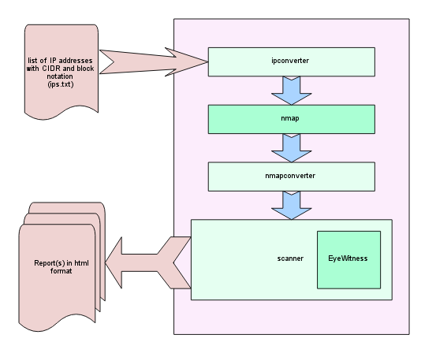
Detection of misconfigured HTTP Services

